Slide 1
FUSION PROTEIN LINKERS THE NEXT FRONTIER OF ONCOLOGICAL RESEARCH
By: Sakshi Pandey
Roll number: BBI-16005

Slide 2
Outline of the presentation
The Genesis(2 minutes)
Objectives and Scope(3 minutes)
Methods and Materials(4 minutes)
Analysis and Results(5 minutes)
Next steps(1 minute)
Supplementary Slides

Slide 3
The Genesis(Problem Formulation) - The Why of the Project.
2 minutes

Slide 4
Fusion Proteins
Fusion proteins can be best defined as chimeras. In greek mythology a chimera is a rare creature which is a hybrid mix between a lion, a goat, and a snake.
Similarly fusion proteins are rare. They are created when two or more genes which are used to code for separate proteins are altered to create a new fusion gene.
Translation of this fusion gene usually results in a polypeptide with functional properties derived from each of the original parent proteins, but in some cases a loss of function or a gain of function can also be observed.

Slide 5
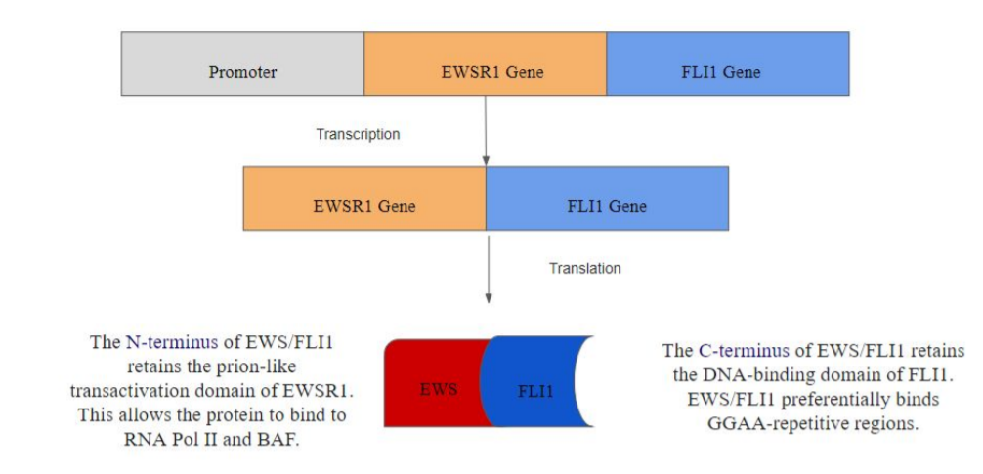
Fusion Proteins

Slide 6
Importance of Linkers
When studying fusion proteins several of our case studies were found to have an extra region in their sequence, one that matched neither of the two fused parent proteins, and resided in between them acting as a linker.
It seems to be a vital structural feature when it comes to protein folding and conformational changes, this was further supported in the literature review.
We hypothesize that this “linker” has been evolutionarily designed because autonomy of the folding units allows better interaction between domains, better interactions with other proteins, and aids the protein to fold into compact structures.

Slide 7
Objectives and Scope of Study-
The What and When
3 minutes

Slide 8
Objectives and Scope of Study
Data collection:
i. Obtain fusion protein sequences and create FASTA(fast-all) files.
ii. To identify linker regions Basic Local Alignment Search Tool for proteins (BLASTp) will be used to perform searches against the non redundant protein database on the fusion protein sequences, and the results will be downloaded as eXtensible Markup Language (xml) files.
iii. A dictionary to identify each corresponding gene in the fusion gene will be designed.
2. Appropriate libraries and python scripts will be used to further parse, clean the results, and isolate the linker regions.
3. A suitable database will be built to store the linker sequences and relevant data. 4. Use machine learning algorithms to observe trends in data.

Slide 9
Objectives and Scope of Study
Data Collection:
i. Proteases and their corresponding proteolytic sites will be obtained.
ii. Python scripts will be used to identify proteolytic sites on the linkers obtained.
iii. Other softwares will be located and used to find sequence and structural properties.
2. A few linkers will be treated as case studies to analyze the usability of the data.
3. Then the programs and softwares will be used on all the linkers detected and stored in the database. The results generated will be added to the existing database.

Slide 10
Literature review
Chromosomal Rearrangement
Cancer Diagnosis
Cancer Treatment
Pharmaceutical Therapies(Targeted vs Non-Targeted)
Combination Therapies and Non-Pharmaceutical Routes of Treatment
The Oncogene Addiction Phenomenon
Disordered Regions at Fusion Junctions, How They are Interesting
Targeting Linker Regions
A Basic Introduction to Proteases and Their Significance
Gaps in Literature

Slide 11
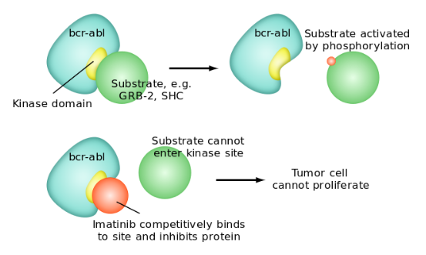
Imatinib’s mechanism of action against BCR/ABL
Source:https://en.wikipedia.org/wiki/File:Mechanism_imatinib.svg

Slide 12
According to our studies, and the literature we have reviewed we have a few interesting points that warrant further discussion.
We believe that the fusion protein linkers play vital roles in chimera proteins.
The linkers may act as conduits to maintain domain organization, as well as playing an important role in domain communication so that the protein has the ability to perform a function post fusion.
In addition to this if they play the aforementioned roles in a protein then its only logical that they also have an important part to play in the chimera protein’s interactions with other proteins.
Since several fusion proteins play vital roles in cell control, and signalling pathways the linker region seems to be a significant area to study and target when looking for cancer treatments.

Slide 13
Gaps in Literature review
From our literature survey we can identify that there's lack of a large dataset of these linkers, and there has also not been a large organized study conducted on them as of now.
We believe that the disordered “linker’ regions containing the translocation breakpoints are of importance to the proteins’ structure and activity.
By identifying these linkers and creating a large database we will be capable of unlocking informative trends and traits that could be crucial to improved targeted therapies to cure cancer.
Notes:
gap is linker regions

Slide 14
End Deliverables-Agreed with Dr. Prasanna
Must Dos’:
To accumulate the required data.
Process the data in order to obtain the linker regions.
Create a database.
100 %
done
Nice to Dos’:
Create a Web Interface to retrieve data from the database and display it.
Add .xlsx file download feature if possible, for further analytics.
Find Proteolytic sites in the linker regions.
Run Analytics in order to infer further features and properties of the linker regions.
200 %
done
Future to Dos’:
Continue accumulating data from more sources in order to create a big data warehouse.
Investigate the use of ML algorithms for the purposes of diagnostics, potential cures, and research.
Create a portal for data mining, analytics, and knowledge management.

Slide 15
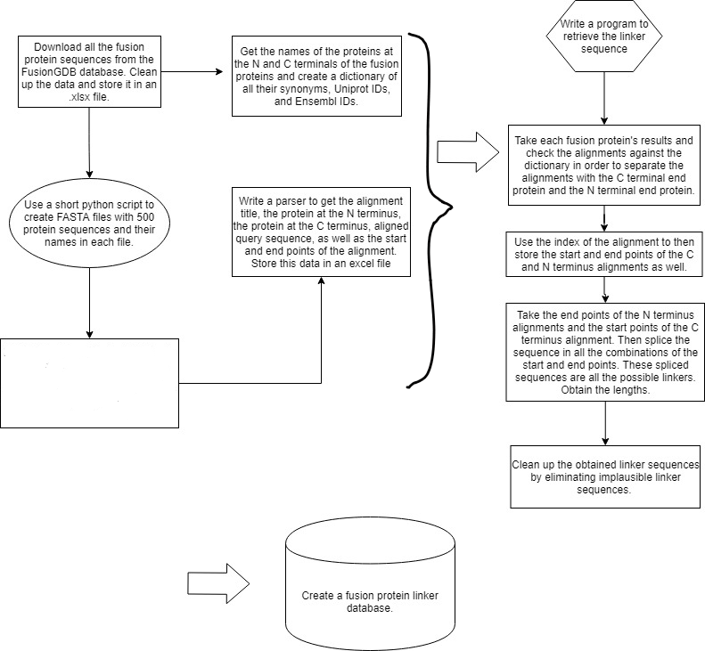
1
2ii
2i
5.
4
3
BLASTp the files against the nr database using the NCBI web interface; Filtering the results for homo sapiens and e values less than 0.5
6.

Slide 16
Gantt Bar Chart
12
01
02
03
04
05
W1
W2
W3
W4
W1
W2
W3
W4
W1
W2
W3
W4
W1
W2
W3
W4
W1
W2
W3
W4
W1
W2
W3
W4
Genesis and Scope Definition
Covid-19 Paper
Preliminary Studies
Step 1-2ii
Step 3 -5
Step 6 and Run Analytics
06
07
W1
W2
W3
W4
W1
W2
W3
W4
Covid-19 Paper
Covid-19 Paper
Create User Interface
Extract Proteolytic Sites of Linker Regions

Slide 17
Materials & Methods -
The Where and How
4 minutes

Slide 18
1
2ii
2i
5.
4
3
BLASTp the files against the nr database using the NCBI web interface; Filtering the results for homo sapiens and e values less than 0.5
6.
Notes:
Research methodology

Slide 19
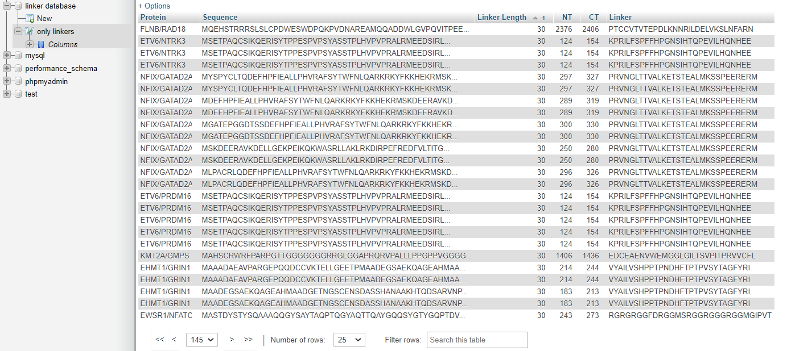
The Gordian Knot DataBase

Slide 20
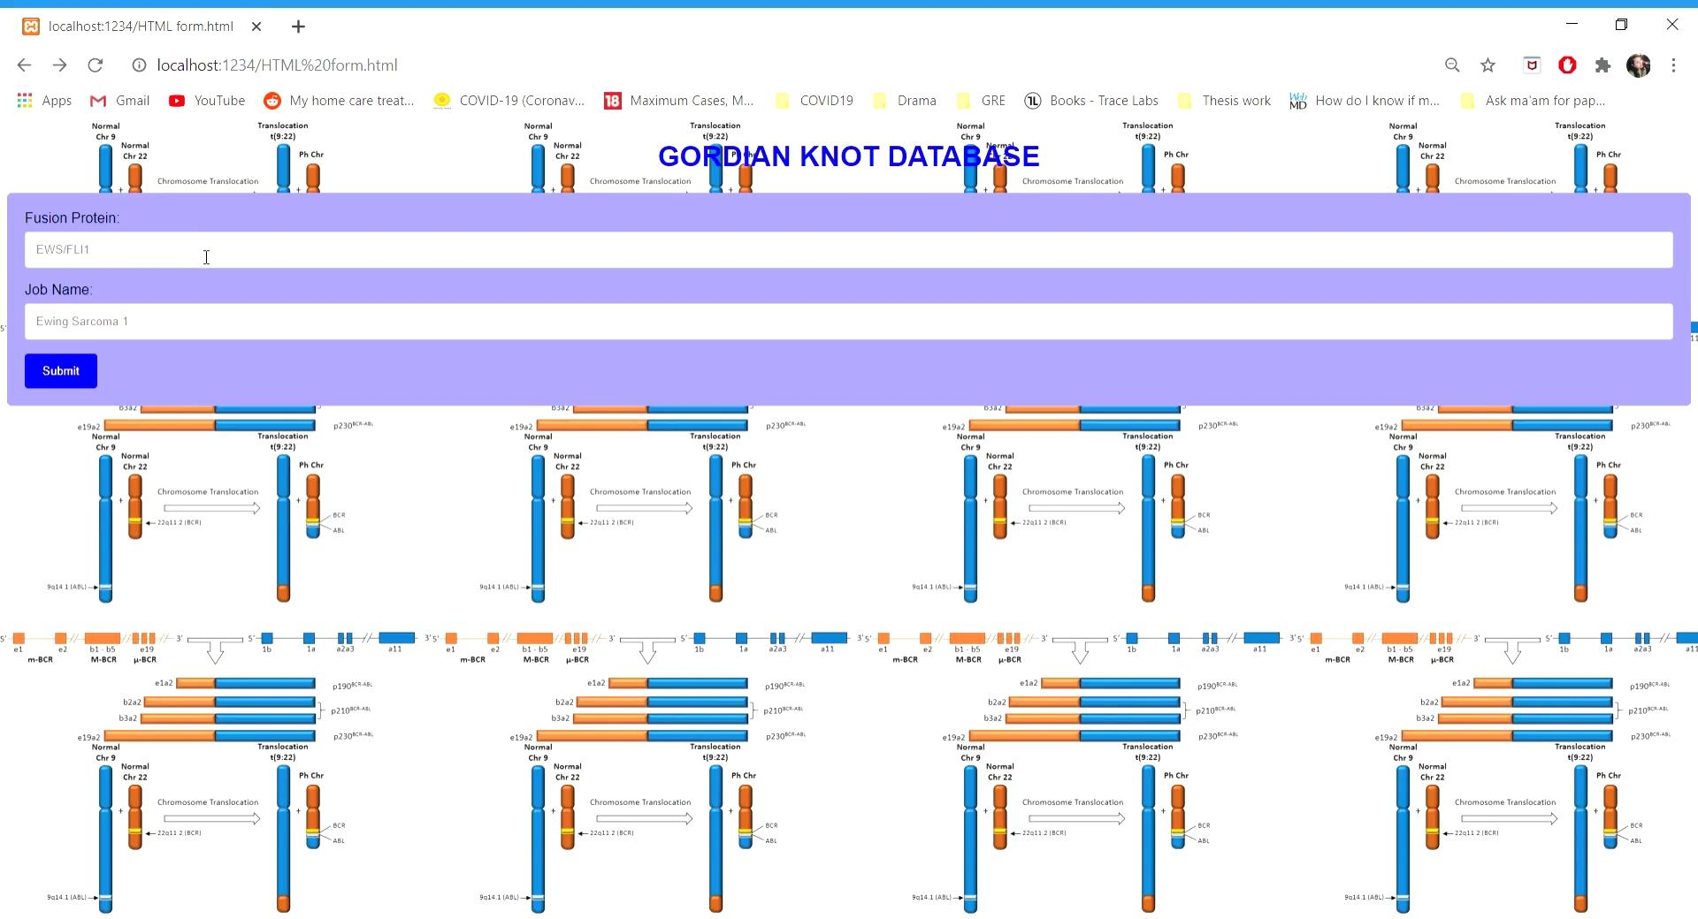

Slide 21
Identifying proteolytic sites within the linker regions
Data Collection:
Proteases and their corresponding proteolytic sites were obtained for serine proteases from the MEROPS database.
Python scripts were then used to identify proteolytic sites on the linkers obtained.

Slide 22
Analysis & Results
5 minutes

Slide 23
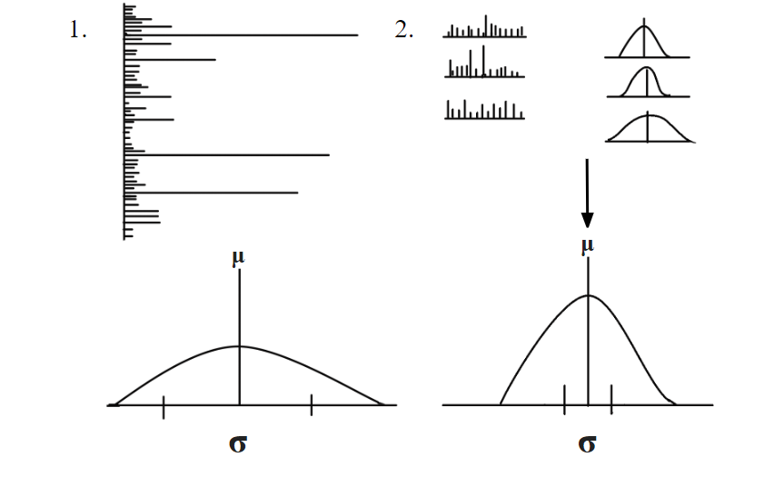
Identification of Linker Length

Slide 24
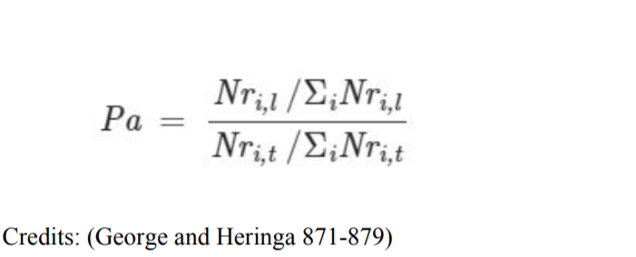
Pa is the propensity for an amino acid i, Nri,l and Nri,t are the number of amino acids type i in the linker set (l) and in the full protein set (t), respectively. ΣNri,l and ΣNri,t are the total number of amino acids in the linker set and in the full protein set, respectively.

Slide 25
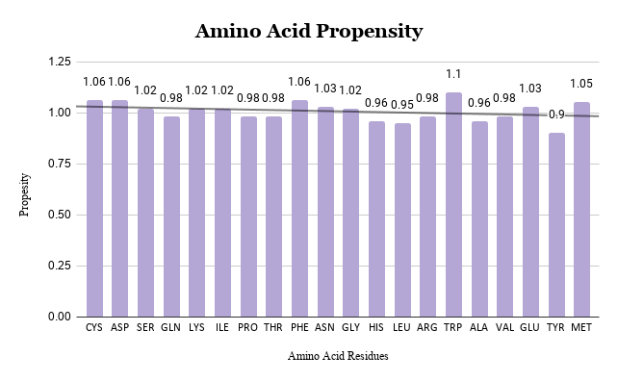

Slide 26
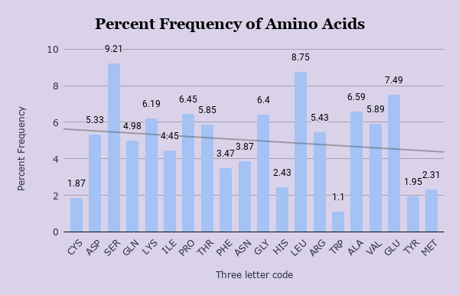
Unusually high frequency of Leucine in oncoprotein linkers
SER
LYS
PRO
GLY
LEU
ALA
GLU

Slide 27
Proteolytic Sites Identified
We have conducted a preliminary analysis where we ran a search for 500 linkers in our database against our dataset of Serine proteases extracted from MEROPS. For 500 linkers we got 10,275 hits of proteolytic sites for the linker regions, this is statistically highly significant and has a large impetus when we explore the curative aspects of future linker studies.
Proteolytic sites allow us to manipulate by activating the proteases that can cleave the fusion proteins, essentially rendering them non-functional in the context of cancer.

Slide 28
Next Steps
1 minute

Slide 29

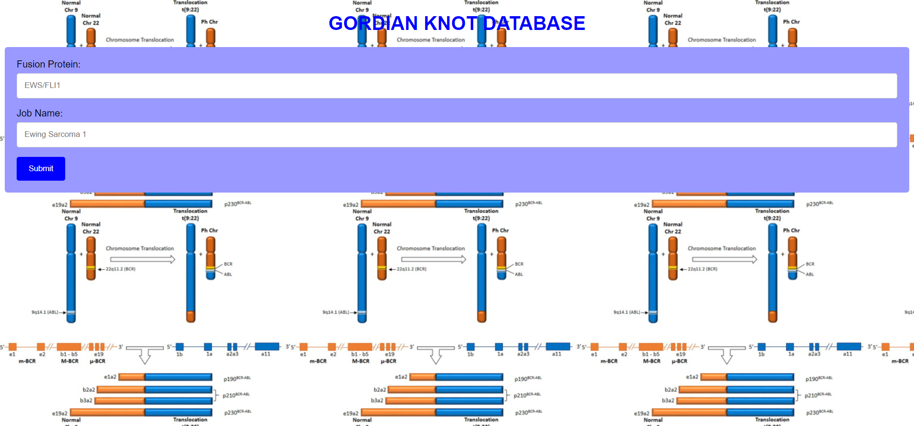
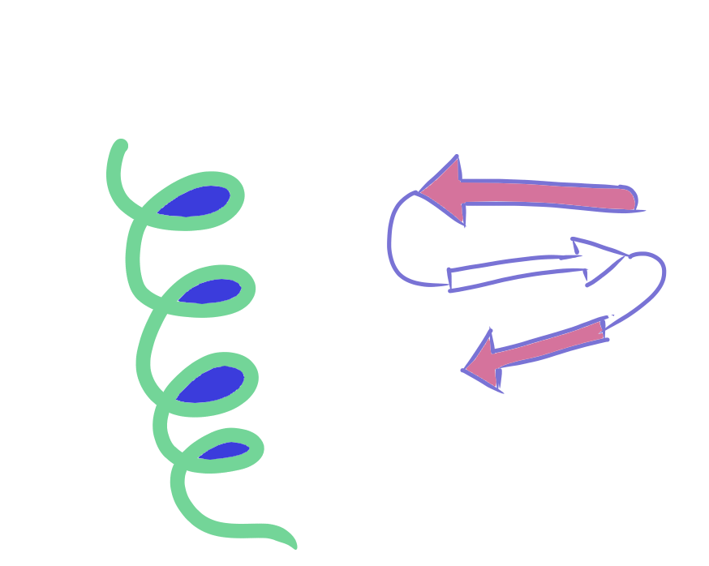

5.Create a comprehensive website to aid the aforementioned work.
4.We hope to further study the secondary structure of linker regions, and include this information in our database.
3ii. Following this a big data warehouse can be created in order to further analyze trends, patterns, as well as use machine learning to be able to find cures, diagnosis, synthetic applications in building linkers in recombinant proteins. As well as discover areas for future research which can be further studied with wet lab work.
Big Data Warehouse
More Data!
3i.In the future we wish to expand our database by collecting more fusion proteins from other databases such as UniProt, COSMIC, and other sources.
2. We also hope to clean our data and observe the results obtained when we parse the data we receive from BLAST more stringently.
Functional
1. Firstly we hope to classify the functions of each parent protein, and include these classifications within the database.

Slide 30
Key takeaways
Immobilize the linker by engineering proteins to bind to the linker region
Activating the protease, or engineering protease to act on the linker region.
For the long linkers which have a potential to interact with other proteins ppi inhibitors can be found/developed.
PLEASE NOTE: This database has a significant potential to revolutionize the treatment of cancer.

Slide 31
Key References
Boroughs, Lindsey K., and Ralph J. Deberardinis. “Metabolic Pathways Promoting Cancer Cell Survival and Growth.” Nature Cell Biology, vol. 17, no. 4, 2015, pp. 351–359., doi:10.1038/ncb3124. 22. Weinstein, I. B., et al. “Oncogene Addiction.” Cancer Research, vol. 68, no. 9, 2008, pp. 3077–3080., doi:10.1158/0008-5472.can-07-3293.
Gutierrez, Carolina, and Rachel Schiff. “HER2: biology, detection, and clinical implications.” Archives of pathology & laboratory medicine vol. 135,1 (2011): 55-62. doi:10.1043/2010-0454-RAR.1
Baselga, J. “Herceptin alone or in combination with chemotherapy in the treatment of HER2-positive metastatic breast cancer: pivotal trials.” Oncology vol. 61 Suppl 2 (2001): 14-21. doi:10.1159/000055397
Gsponer, J., Futschik, M. E., Teichmann, S. A., and Babu, M. M. (2008). Tight regulation of unstructured proteins: from transcript synthesis to protein degradation. Science 322, 1365–1368. doi: 10.1126/science.1163581 26. Uversky, V. N. (2013). Intrinsic disorder-based protein interactions and their modulators. Curr. Pharm. Des. 19, 4191–4213. doi: 10.2174/1381612811319230005
Hegyi, Hedi, et al. “Intrinsic Structural Disorder Confers Cellular Viability on Oncogenic Fusion Proteins.” PLoS Computational Biology, vol. 5, no. 10, 2009, doi:10.1371/journal.pcbi.1000552.
Uversky VN, Oldfield CJ, Dunker AK (2005) Showing your ID: intrinsic disorder as an ID for recognition, regulation and cell signaling. J Mol Recognit 18(5): 343–84. 29. Dyson, H., Wright, P. Intrinsically unstructured proteins and their functions. Nat Rev Mol Cell Biol 6, 197–208 (2005). https://doi.org/10.1038/nrm1589

Slide 32
Key Statistics of the Project
7455 linkers were found and stored in the database.
Over 30+ PROGRAMS written in Python in order to obtain the linker dataset.
WEBSITE: written in php, html, css, and javascript.
100% of the MUST DOS’ were achieved.
100% of the NICE TO DOS’ were also achieved!
The database is being further refined and we hope to publish a manuscript on it soon.
--THE END--

Slide 33
Supplementary Slides

Slide 34
Pharmaceutical Therapies(Targeted vs Non-Targeted)
Targeted Therapies | Non-Targeted Therapies
Highly effective in selected hematopoietic malignancies, most have shown limited efficacy against complex solid tumors(Hait et al. 1263-1267) | Non targeted drugs are more successful and effective in general when compared to targeted therapies
Targeted therapies are just that, targeted, this means that there are fewer toxic effects associated with them, and fewer side effects. | Non targeted drugs are also some of the most toxic drugs, unlike targeted therapies they tend to have several severe side effects which make them unpalatable to be used for treatment.
However time costs are also associated with targeted therapies as molecular targets need to be identified before a drug can be designed. | There aren’t extensive time costs for non targeted therapies like there are for targeted therapies.

Slide 35
The Oncogene Addiction Phenomenon
In a phenomenon known as oncogene addiction, cancerous cells rely on oncogenes and their products to play their specified role in order to function and survive (Jones and Thompson 537-548).
Boroughs and Deberardinis say in their paper that the activation of oncogenes and loss of tumour suppressors causes metabolic reprogramming to take place in the cell, leading to increased nutrient uptake to supply the cancerous growth.
For example, oncogenic addiction may force cancer cells to rely on a certain metabolic pathway for growth (Jones and Thompson 537-548).

Slide 36
Disordered Regions at Fusion Junctions, How They are Interesting
Intrinsically disordered proteins have often been a common factor for various diseases such as various neurodegenerative and cardiovascular diseases, as well as cancer and diabetes. This has made them the subject of intense research in recent years. Some of their most prevalent traits are:
Conformational adaptability
Structural plasticity
Ability to react more readily in response to changes in their environment.
Binding promiscuity, their ability to fold differently when interacting with varying binding partners.
More diverse roles in processes.

Slide 37
Targeting Linker Regions
To design treatments targeting intrinsically disordered regions is difficult, due to how flexible and dynamic the regions inherently are.
One of the most successful approaches according to the research conducted by Santofimia-Castaño is using small molecules.
Two perspectives exist when it comes to using small molecules to target. The first perspective involves identifying some short intrinsically disordered region that may be imperative in protein function.
The second perspective is achieved when a small molecule, identified by some screening protocol, binds to an important intrinsically disordered region, usually, but not always at a hot spot.

Slide 38
Example for cis and trans
An example of such a case has been studied by Sarkar et al. (413), the paper found that a proline on the linker tethering the two SH3 domains of the Crk adaptor protein interconverts between the cis and trans conformation. In the cis conformation, the two SH3 domains interact intramolecularly, thereby forming the basis of an autoinhibitory mechanism. Conversely, in the trans conformation Crk exists in an extended, uninhibited conformation that is marginally populated but serves to activate the protein upon ligand binding. This along with various other studies support the hypothesis that the linker in fusion proteins should be a region of interest.

Slide 39
Leucine’s presence
Normally hydrophobic residues induce structure in the protein sequence, since they would logically want to fold and not be exposed to solvent.
This led us to hypothesize that the clusters of hydrophobic residues we observed in linker regions may mean that the disordered region folds and becomes ordered, it may mean that there’s an ability to bind and have a secondary structure.
This could be supported by the fact that most of the oncoprotein linkers are longer than normal protein linkers, meaning there may be a higher probability of structure being present in the sequence.

Slide 40
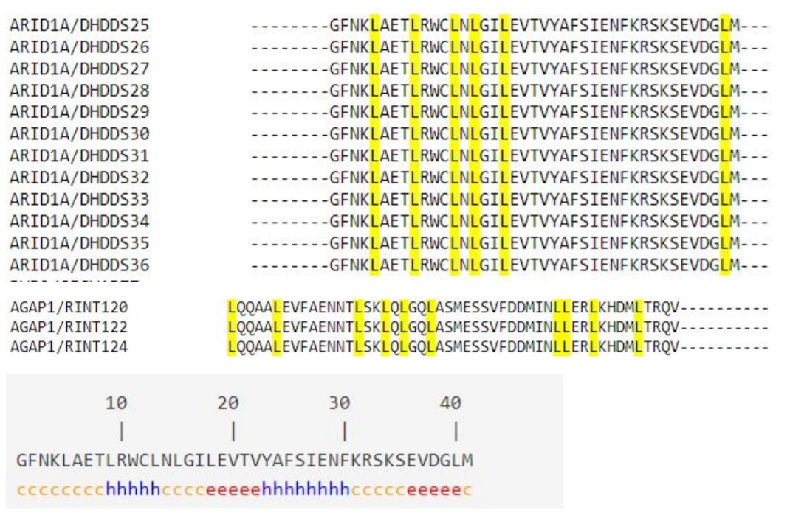
Leucine’s presence
These patterns could be indicative of some structure to the sequence, similar patterns are seen in sequences with leucine zippers, and we believe there could be some significance to this, and that further study on the secondary structure of all the linker sequences and amino acid propensities is warranted. These studies may lead to interesting findings and further our understanding of the function of the linker regions.

Slide 41
Benefits
The huge benefit of such treatments is that the therapy has potential to replace the more toxic treatment alternatives (with their ensuing future side effects) in cancer. In addition to this biomolecules are being more and more preferred in treatment due to their inherent trait of normally not raising antibodies. Such a discovery could have a profound impact on cancer research and treatment.As we endeavor to continue to accrue big data on Fusion proteins and their linkers we hope to continue making significant discoveries as we mine to gain better knowledge of their structures, sequences, function, and behaviors.

Slide 42
Humans Vs. Machines
Research advances one death at a time
Biases
Bounded rationality
Slower learning curve
Lesser memory capacity
Humans
Can be used to really expedite the research process(ex. WebMD)
Not prone to biases
Unfalteringly rational
Show an exponential learning curve
Very high memory capacity
Machines

Slide 43
PERCEPTION OF KNOWLEDGE
Known Known | Known Unknown
Unknown Known | Unknown Unknown
MANKIND’S KOWLEDGE
AI/ML
My Choice in Project

